Slide 1

Clinical Research in an Age of Collaboration:
Together we can do bigger and better
Daren K. Heyland
Professor of Medicine
Queens University, Kingston General Hospital
Kingston, ON Canada
Notes:
If you honor me for the spirit of collaboration that I represent, it is only because I have been able to plug into a broader community of receptive colleagues who engage and enable us to do these special projects. Thanks Charlene for recognize that wondership spirit of collaboration in our community and I am humbled to be able to give a ‘voice’ to that concept.

Slide 2

Notes:
Want to talk about several transformative ideas that will shape the way we see ourselves, the way we interact as a society, and what we expect of our societal leadership and ourselves.

Slide 3
My Big Idea
• Creation of volunteer-driven, registry-based RCTs
• Formation of research networks to foster the growth
  or large scale projects
• Engagement of patients and families as our partners
• Shift away from physiological measurements and
  mortality to more rigorous patient centered outcomes
  including activity and performance-based measures
Notes:
Those ideas are…

Slide 4
!
The Problem
• Numerous challenges to providing optimal nutrition to
individual patients in our health care system.
• Partly due to devaluation or de-prioritization of nutrition
issues relative to other clinical problems our patients face.
CONSEQUENCES
! Malnutrition continues to go unassessed,
! Significant underfeeding continues in institutionalized care
! Patients experience the attendant negative consequences of nutritional insufficiency
Notes:
But let’s start in the beginning with defining the problem.

Slide 5

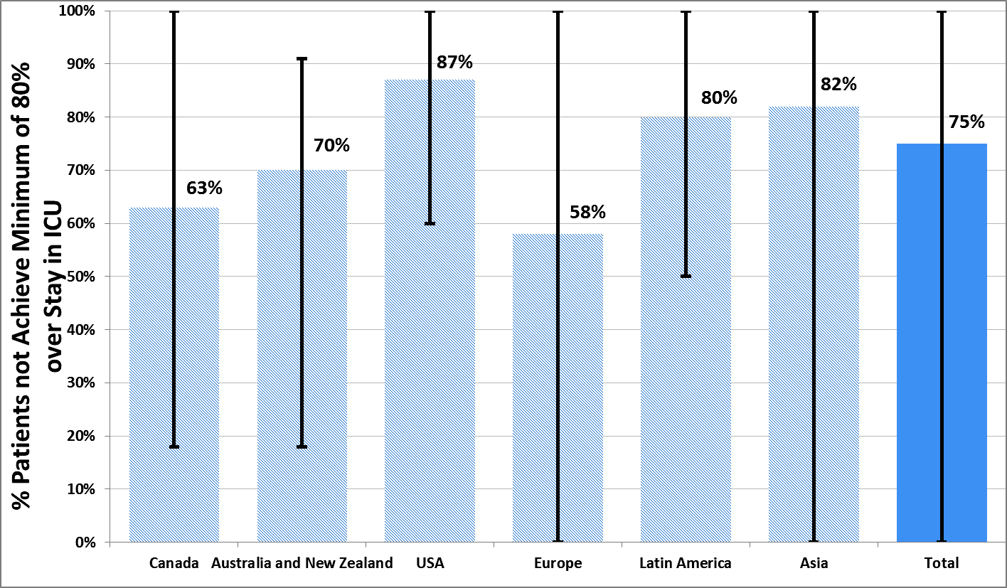
The Prevalence of Iatrogenic Underfeeding in the
Nutritionally ‘At-Risk’ Critically Ill Patient
% Patients who FAILED to meet minimal quality targets
(80% overall protein/energy adequacy!)
Of all at-risk patients:
14%
were ever prescribed volume-based feeds
15%
received sPN
Heyland
Clinical Nutrition 2015

Slide 6

Canadian Malnutrition Task Force
Prospective Cohort Study
• 1015 Patients in 18 Canadian hospital 2010-2013
• Malnutrition on Admission: 45% of patients ¹
• Malnutrition associated with:
-longer length of stay longer (hazard ratio 0.73 95% CI, 0.62-0.86)
-increased 30-Day readmission ²
-increased mortality ³
• Costs of Malnutrition 31-34% higher ⁴
Allard et al. JPEN 2016 May;40(4):487-97
Jeejeebhoy et al. Am. J. Clinical Nutritional 2015;101(5):956-65
Laporte et al. Eur J. Clin Nutr. 2015;69:558-64
Curtis et al. Clinical Nutrition 2016 Epub ahead of print

Slide 7
?
Why is Clinical Nutrition SO Undervalued?
            • Large part of the problem is due to weak or absent evidentiary
            basis that informs our clinical practice.
            Evidence for this assertion comes from a review of recent clinical
            practice guidelines.
            Some guideline developers suggest a minimum of 2
    multi-center, large scale trials are warranted before evidence can
    be incorporated into treatment recommendations.
    • The nature of the evidence informing these guidelines reveals few
    strong clinical recommendations and numerous small, low-moderate
    quality single center randomized trials.
Notes:
Could it be due to the fact ….. Think about the last time you tried to assert your self that we need to feed this patient more and a physician said, ‘what’s the evidence for that’… and if left you speechless and struggling

Slide 8

Randomized Trials in Critical Care Nutrition
Since 1976, 290 RCTs of Critical Care Nutrition Therapies

Slide 9
Randomized Trials in Critical Care Nutrition
Since 1976, 290 RCTs of Critical Care Nutrition Therapies
Average # of Patients per Trial

Slide 10
Randomized Trials in Critical Care Nutrition
Since 1976, 290 RCTs of Critical Care Nutrition Therapies
Average Methodological Score

Slide 11
Canadian and ASPEN/CCM CPG’s:
Strength of Underlying Evidence
Canadian CPGs
ASPEN/SCCM
Language
Condition
# of topics
Language
Condition
# of topics
Insufficient Data
Inadequate or conflicting evidence
28 (45%)
Ungraded
5 (15%)
Should be or not be considered
Supportive evidence weak and/or major uncertainties about safety, feasibility or costs of intervention
15 (24%)
Very low quality
GRADE scoring; RCT or observational study; very serious limitations, inconsistencies w data
9 (27%)
Very low to low
1 (3%)
Low quality
GRADE scoring; RCT or observational study; very serious limitations to study quality
7 (21%)
Recommend or do not recommend
Evidence supportive but minor uncertainties about safety, feasibility, or costs of intervention
17 (27%)
Very low to moderate
5 (15%)
Moderate quality
GRADE scoring; RCT; serious limitation to study quality
3 (9%)
Moderate to high
3 (9%)
  Strongly recommend
No reservations about endorsing intervention
2 (3%)
High quality
GRADE scoring; RCT
0
Totals
62
33

Slide 12
Comparisons of Canadian CPG’s, ASPEN/SCCM
CPG’s and Surviving Sepsis CPG’s

Slide 13
Even RCT’s have their limitations!
Fail to show a ‘signal’ of benefit
Limited generalizability
Very Costly

Slide 14
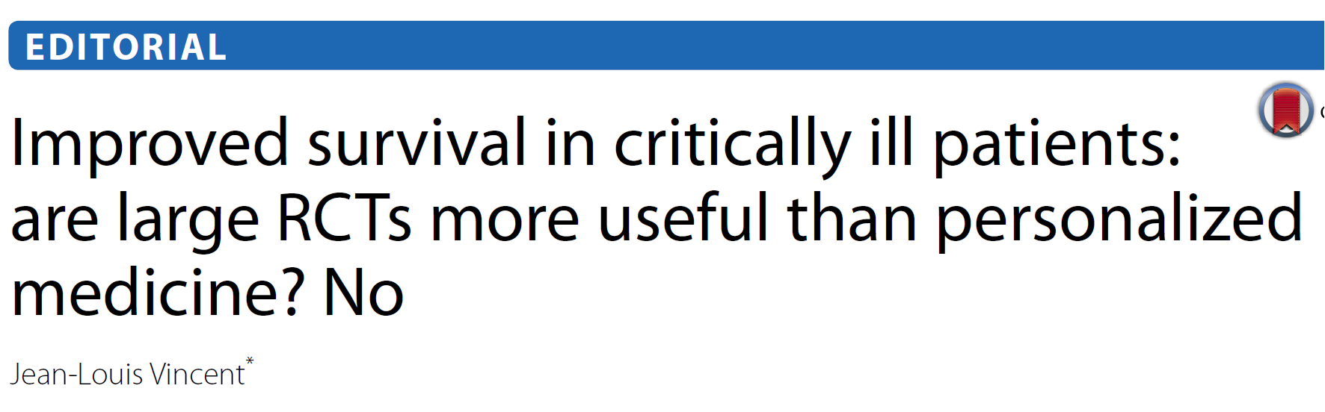
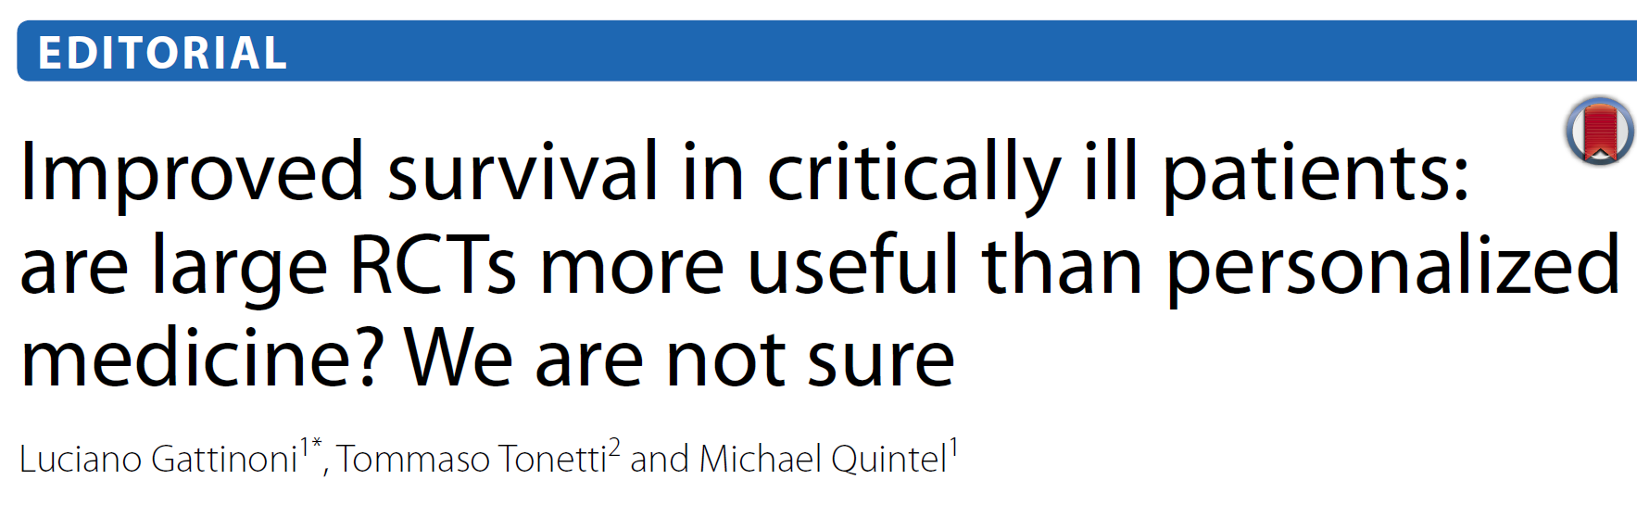
Are Large-scale RCT’s the Solution?

Slide 15
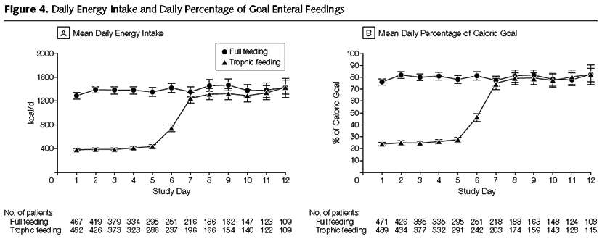
The EDEN Randomized Trial
Initial Tropic vs. Full EN in Patients with Acute Lung Injury
Rice TW, et al. JAMA. 2012;307(8):795-803.

Slide 16
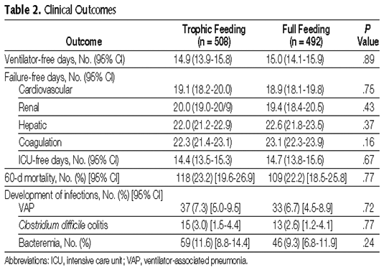
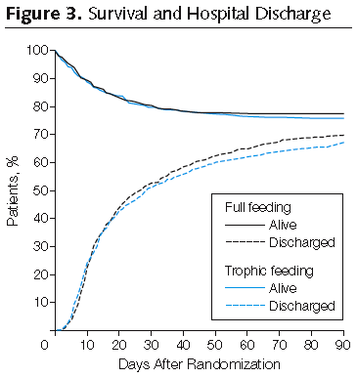
The EDEN Randomized Trial
Initial Tropic vs. Full EN in Patients with Acute Lung Injury
Rice TW, et al. JAMA. 2012;307(8):795-803.

Slide 17
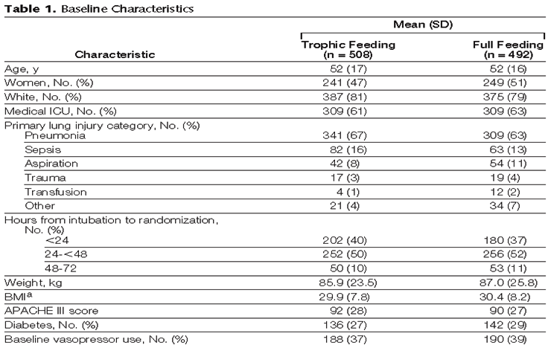
Generalizability of RCT Results
Initial Tropic vs. Full EN in Patients with Acute Lung Injury (EDEN trial)
Enrolled 12% of patients screened
60 Day Mortality 23%
Rice TW, et al. JAMA. 2012;307(8):795-803.

Slide 18
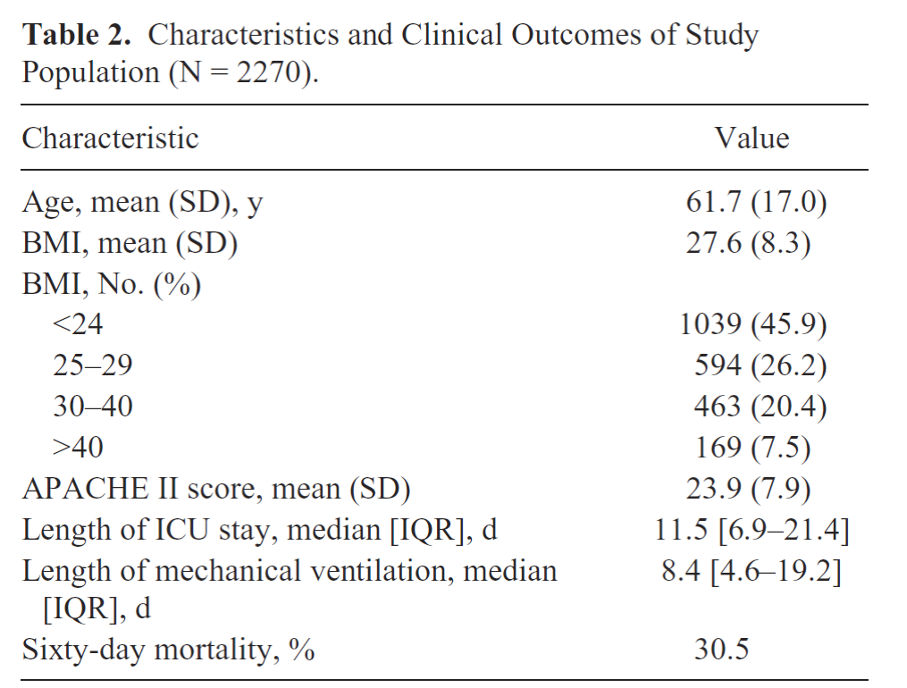
Generalizability of RCT Results
Observational Study of Nutrition Intake and Outcome in Sepsis
Treatment effect may be proportional to baseline risk!!
Elke, Critical Care 2014;18:R29

Slide 19
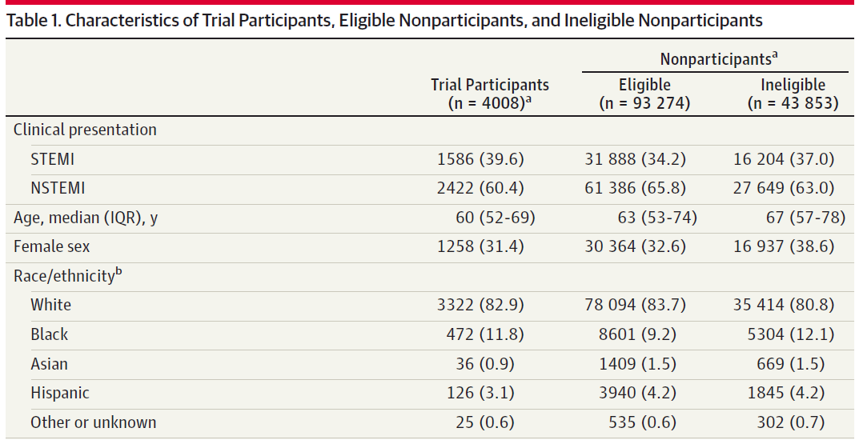
Generalizability of RCT Results
Clinical Trial Participation vs. Registry
Udell JAMA 2014
Udell JAMA 2014

Slide 20
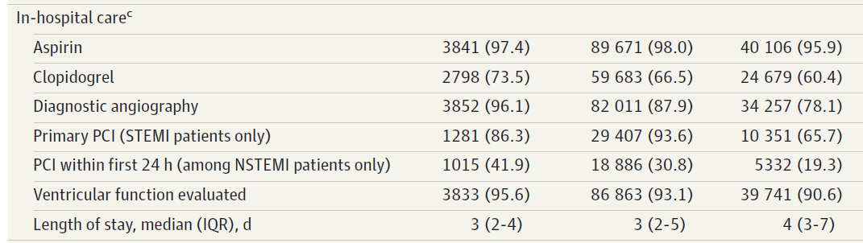
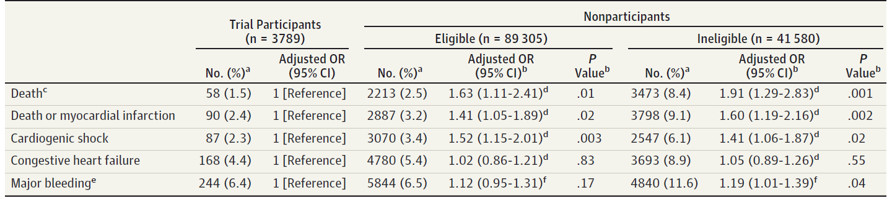
Clinical Trial Participation vs.
Registry Data in AMI
Udell JAMA 2014
Udell JAMA 2014
Udell JAMA 2014
Notes:
Whats my point- that selected patients in an RCT MAY not be representative of patients you see in real life. Therefore the results are not generalizable to real practice. And to the extent that treatment effect varies by baseline risk. By including ‘not as sick’ or ‘younger’ patients, you may miss an important signal. Besides…

Slide 21
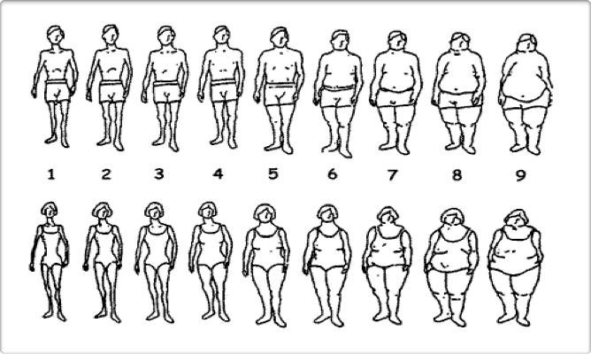
ICU Patients Are Not All Created Equal…
Should We Expect the Impact of Nutrition Therapy to be the Same Across All Patients?
Notes:
Need to study more homogenoous patient populations that are in some way take into consideration of their underlying risk

Slide 22
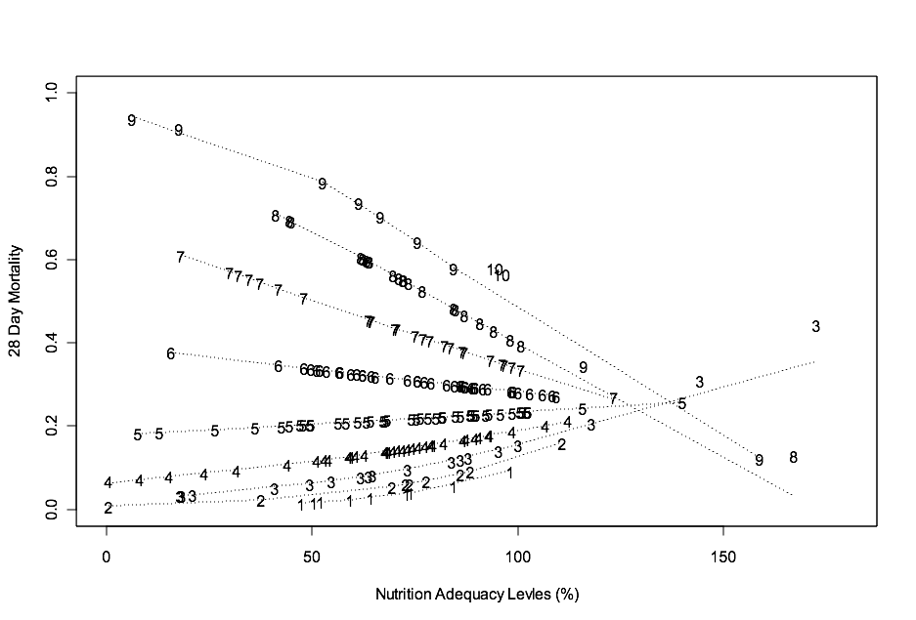
The Validation of the NUTrition Risk in the Critically Ill Score (NUTRIC Score)
Interaction between NUTRIC Score and nutritional adequacy (n=211)*
Heyland
Critical Care 2011, 15:R28

Slide 23
The Validation of the NUTrition Risk in the Critically Ill Score (NUTRIC Score)
Validated in 3 separate databases including the INS Dataset involving over 200 ICU’s worldwide ^{1,2,3}
Validated without IL-6 levels (modified NUTRIC) ²
Independently validated in Brazilian, Portuguese, and Asian populations ^{4,5,6}
Not validated in post hoc analysis of the PERMIT trial ⁷
– RCT of different caloric intake (protein more important)
– Underpowered, very wide confidence intervals
Heyland Critical Care 2011, 15:R28
Rahman, Clinical Nutrition 2013.
Compher, CCM, 2016 (in press)
Rosa Clinical Nutrition ESPEN 2016
Medes J Crit Care 201
Mukhopadhyah Clinical Nutrition 2016
Arabi AmJRCCM 2016

Slide 24
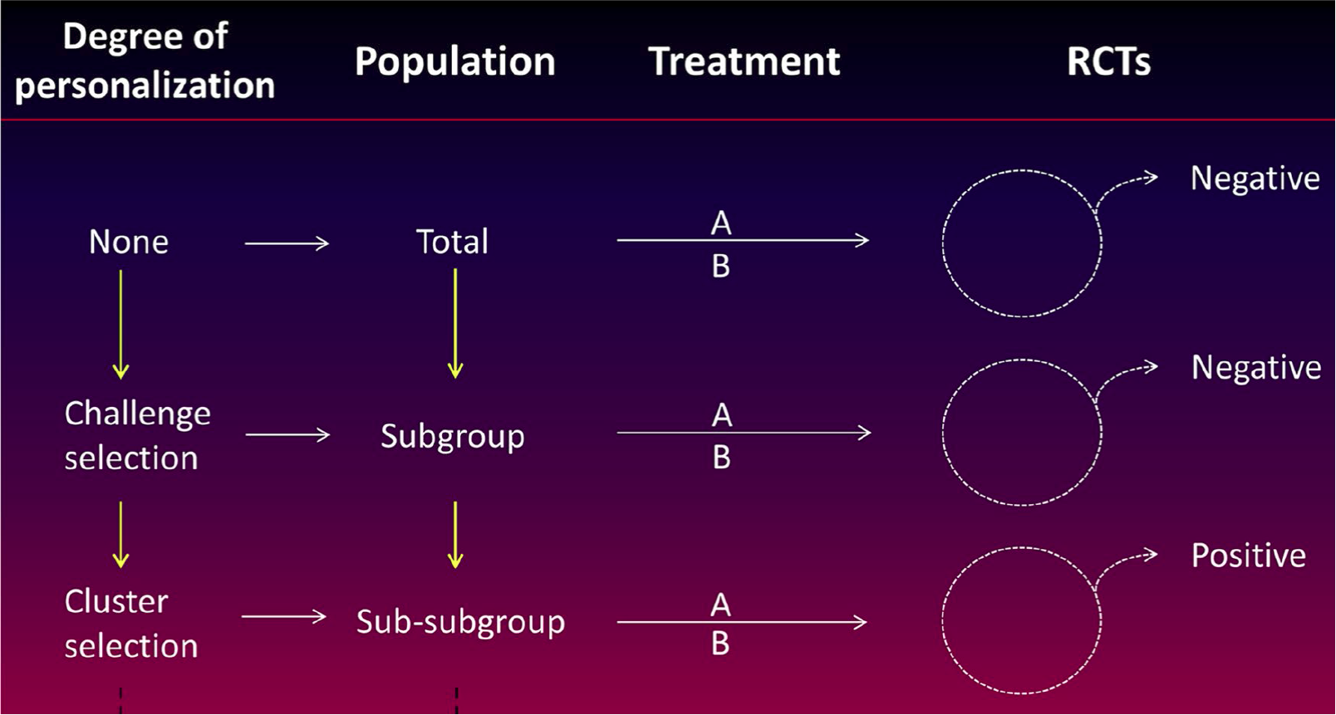
Move Towards Personalized Medicine …and away from large RCT’s of heterogeneous patients!
Intensive Care Med (2016)42:1781-1783

Slide 25
Results of TOP UP Pilot Trial
A RCT of supplemental PN in low and high BMI ICU patients
Post-hoc subgroup analysis
Critical Care ‘in press’

Slide 26

Large Scale trials are Expensive!
A RandomizEd Trial of ENtERal Glutamine to MinimIZE Thermal Injury:
EN glutamine
2700 patients with TBSA
≥ 20% if 18-59 yrs age
≥ 15% if 18-59 yrs age
with inhalation injury
≥ 10% if ≥ 60 yrs age
R
Concealed
Stratified by site
Double-blind
6 month mortality
Maltodextrin
placebo
$6 million CDN
$6 million USD pending
Notes:
Homogeneity and lack of generalizability are not the only problems related to RCTs. Describe trial… “Guess how much it costs”

Slide 27

Large Scale trials are Expensive!
SodiUm SeleniTe Administration IN Cardiac Surgery (SUSTAIN CSX®-trial)
Alive and free of POD
Or Time to freedom from life-sustain treatments
Double blind treatment
IV Selenium
1400 high-risk
patients undergoing
cardiac surgery
R
Concealed
Stratified by site
placebo
$ 3 million CDN

Slide 28

?
What can be done to rectify this situation?
How do we enable the generation of higher quality, larger scale, multi-center, randomized clinical trials of homogenous patient populations that will inform more robust future practice guidelines?
Ultimate goal is to improve patient outcomes!

Slide 29

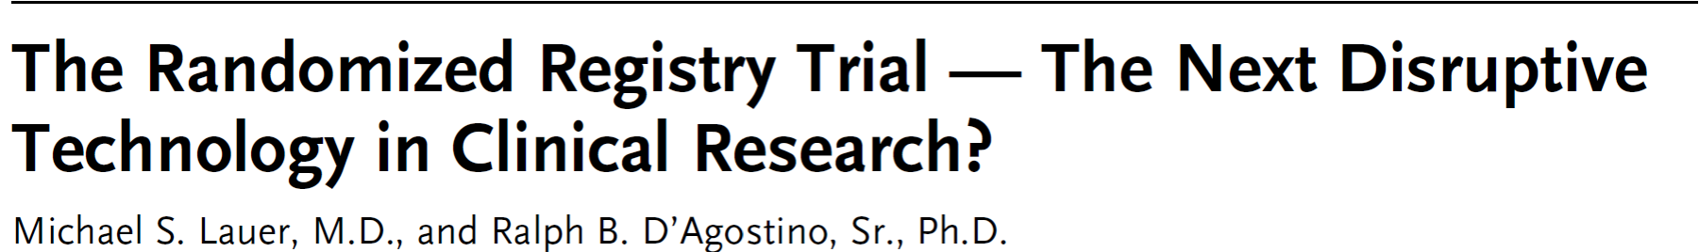
Clinical registries are established tools for auditing clinical standards and benchmarking QI initiatives
Data from clinical registries can be used to formulate hypothesis
With appropriate methods, make causal inferences (albeit weaker inference)
Results more generalizable
NEJM 369;17:1579

Slide 30
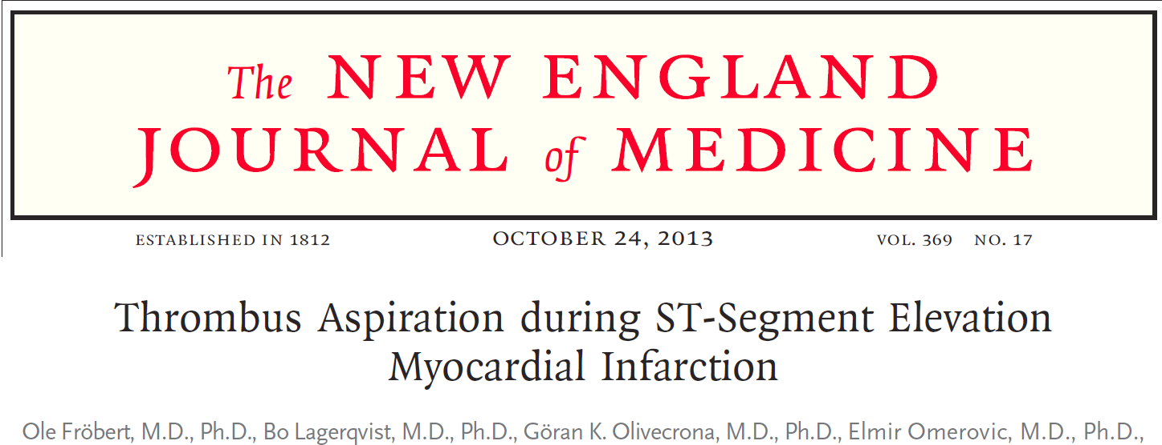
Randomized patients undergoing angioplasty to manual thrombus aspiration or usual care.
Used existing national cardiac registries
Over 7000 patients were efficiently recruited from the registry
Aside from the randomized intervention, the trial imposed no other study procedures and all data were collected by existing registries supported by funds from national or other hospital sources.
Total incremental cost 300,000 Euros; 50 Euros/patient enrolled!
Am Heart J 2010:160:1042 and NEJM 2013;369:1587

Slide 31

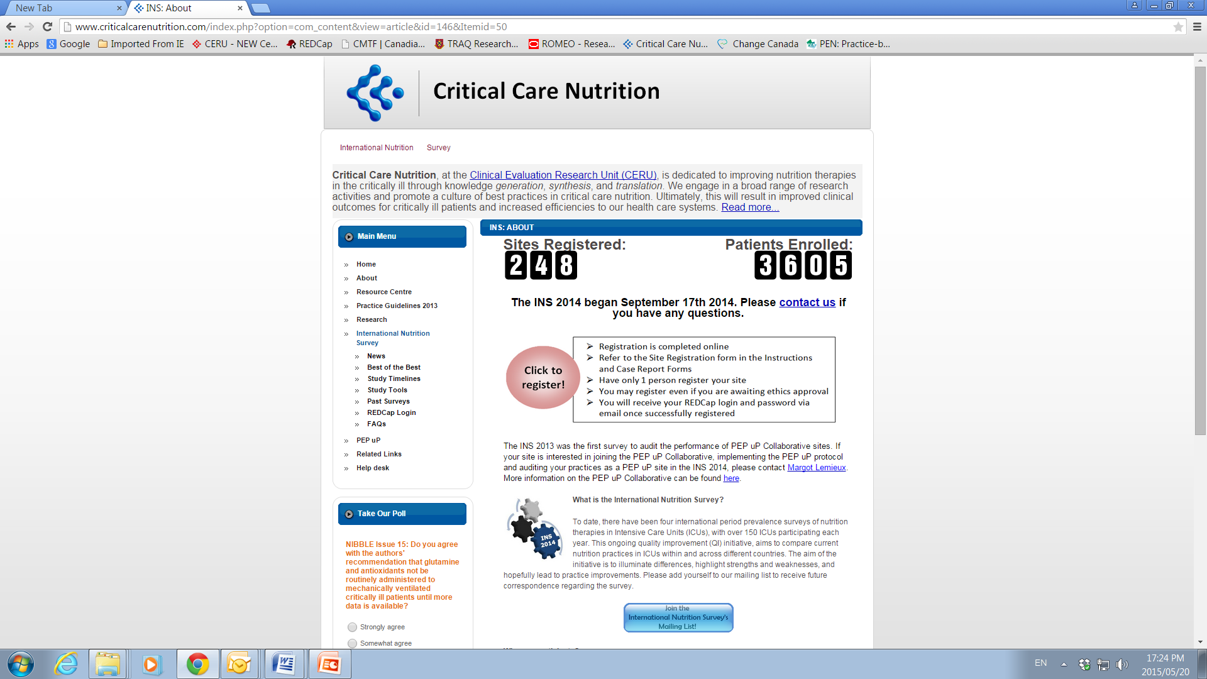
Can we exploit the International Nutrition Survey to perform RRCTs?

Slide 32

Participation Across the 5 Years of the Survey : 708 Distinct ICUs
Canada: 95
USA: 225
Europe and Africa: 109
Asia: 145
Colombia:19
Brazil:10
Argentina:7
Uruguay:5
Mexico: 3
Chile:3
Venezuela:2
Peru:1
Paraguay:1
El Salvador:1
Puerto Rico:1
UK: 37
Turkey: 11
Ireland: 12
Italy: 9
Norway: 8
South Africa: 13
Switzerland: 4
Spain: 4
Slovenia:1
Sweden: 3
Czech Republic:3
Austria:2
Portugal:1
France:1
China: 38
Japan: 43
India: 36
Taiwan:5
Singapore: 11
Saudi Arabia:2
Philippines:2
Iran : 2
Thailand: 2
UAE:1
Malaysia:2
Indonesia:1
Latin America: 53
Australia: 73 New Zealand: 8
Notes:
Ask by show of hands whose institutions have participated years past. You are living testimonies of the spirit of collaboration that already exists in our community. THANK YOU. the question is whether we can leverage this collaboration and continue the partnership and perform an RCT in the context of this initiative?

Slide 33

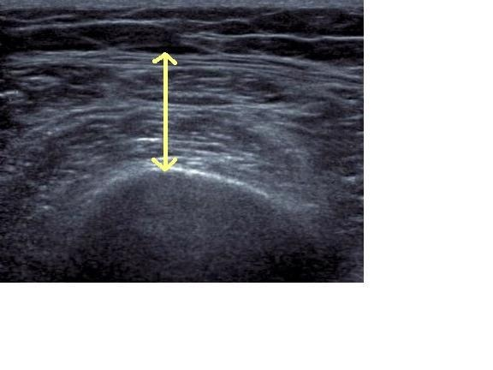
VALIDation of bedside Ultrasound of Muscle layer thickness of the quadriceps in the critically ill patients: The VALIDUM Study
An Example of a Multi-center, Volunteer-Driven Study Done by Dietitians who had to Obtain Informed Consent
Study Procedures
7 ICUs in USA
N = 149 patients with CT Scan Abdomen for clinical reasons
CT Scan
Enroll
For every CT scan collect US of Quad MLT
Paris
JPEN 2016

Slide 34
Registry-based Randomized Clinical Trials (RRCT)
A possible solution?
Traditional Registries | INS Registry
Consecutive enrollment | Episodic enrollment
All patients | Select patients
Funded by health care systems | Volunteer-driven
Variable data quality management | Limited data quality management

Slide 35
Registry-based Randomized Clinical Trials (RRCT)
A possible solution?
Best suited for open-label evaluation of commonly used therapeutic alternatives
Where there is limited funding (not-industry driven)
Where endpoints are easily measured, objective, and available (nutritional adequacy; 60 day mortality)
Utilize a simple trial design with open-label randomization, limited eligibility criteria to maximize enrolment and generalizability, and data collected by existing registries (or supported by volunteers).

Slide 36
Could the INS infrastructure be used to Randomize Patients?
In 2014 INS, on average, patients were prescribed 1.3 grams/kg/day (interquartile range, 1.0-1.5 grams/kg/day,
overall range, 0.5-3.8 grams/kg/day).
Extra protein for 7-10 days
Stratified by:
Site
BMI
Med vs Surg
Primary Outcome
ICU patients
R
Fed enterally
60 day
mortality
Nutric >5
Standard underfeeding

Slide 37
Could the INS infrastructure be used to Randomize Patients?
In 2014 INS, 86% received a polymeric formula
Standard Polymeric Diet
Primary Outcome
ICU patients
R
Stratified by:
Site
BMI
Med vs Surg
Started on EN
Overall ICU Nutritional Adequacy
Standard Semi-digested Solution

Slide 38
Could the INS infrastructure be used to Randomize Patients?
In 2014 INS, of the patients who received PN: 37% alternative lipid emulsion. 37% Lipid free, 25% Soy bean emulsion
Alternative Lipid Emulsion
ICU patients
R
Stratified by:
Site
BMI
Med vs Surg
Primary Outcome
Started on PN
60 day
mortality
Standard Soy-Bean Emulsion

Slide 39
Could the INS infrastructure be used to Randomize Patients?
In 2014 INS, less than 10% using PEP uP Protocol
PEP uP Protocol
ICU’s interested
in improving
practice
cR
Stratified by:
Site
BMI
Med vs Surg
Primary Outcome
60 day
mortality
Standard Enteral Feeding Protocol

Slide 40

The Effect of High versus Usual Protein Dosing in Critically Ill Patients
The EFFORT Trial
Target >2.0 gram/kg/day
A multi-center, pragmatic, volunteer-driven, registry-based, randomized, clinical trial for BOTH adults and paediatrics.
Primary Outcome
ICU patients
R
Stratified by:
Site
BMI
Med vs Surg
Fed enterally
60 day
mortality
Nutric >5
Target <1.2 gram/kg/day

Slide 41
Lots of Issues!
Ethics?
Contracts?
Regulatory environment?
Funding?
Maintaining quality?

Slide 42
Statistical Considerations
Large pragmatic trial with little effort to restrict participation of sites and patients nor standardize co-interventions will increase noise
Will have to power for smaller treatment effects which will increase sample size requirements
If 60 day mortality is primary outcome, 1500 per group may be needed (n=3000 total).
If TTDA at 60 days is primary outcome, 900 per group needed (n=1800 total).

Slide 43
Potential Barriers and Threat
SUSTAIN experience important to consider
    Continuous data collection too onerous
    What we propose is more episodic
Extra workload required to data entry
    Partnership with industry to create wireless transmission of pump data to a cloud-based repository that merges with INS data
Lack of products available at all sites
Lack of a sustainability plan (if we build it, will they come!)
Others!?

Slide 44
Value of Bench-marked Site Reports
Recommendations: Based on 8 level 2 studies, we recommend early enteral nutrition (within 24-48 hrs following resuscitation) in critically ill patients.
Early vs Delayed Nutrition Intake

Slide 45
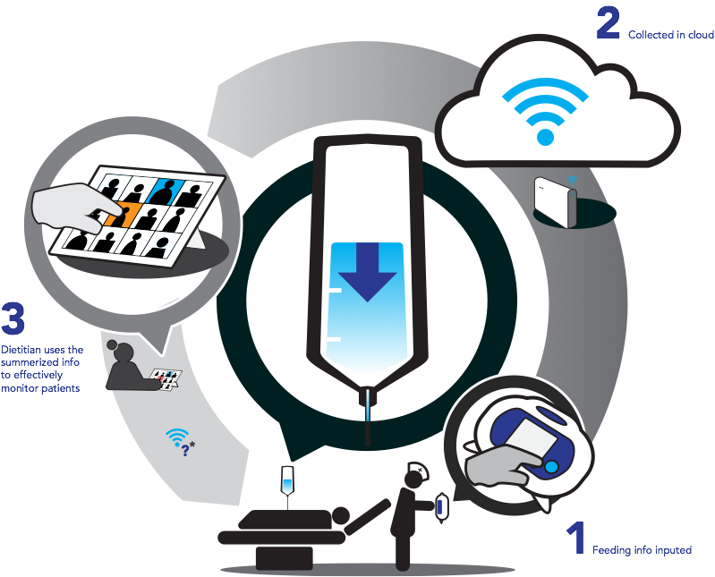
INFORM (Integrated Nutrition Monitoring Platform)

Slide 46
Potential Facilitators
Value of Bench-marked reports
Enhanced professionalism
Large organization, such as ASPEN, will see value to these efforts that help prove that nutrition intervention matter.
Because we require physicians and dietitians to work together on this, fosters multi-professional approach and physician engagement
Value of a large dataset that can be used by the community for secondary purposes
Opportunities for academic involvement and advancement
Others?

Slide 47
Critical Questions?
Can we see the signal through the noise?
Will the clinical nutrition community rally around this effort and provide the volunteer support needed for success?
How will this kind of trial be evaluated by our peers?
If so, what is the sustainability plan?
Others?

Slide 48
My Big Idea
• Creation of volunteer-driven, registry-based RCTs
• Formation of research networks to foster the growth
  or large scale projects
• Engagement of patients and families as our partners
• Shift away from physiological measurements and
  mortality to more rigorous patient centered outcomes
  including activity and performance-based measures

Slide 49








Creation of Research Networks

Slide 50
Protocol Development Meetings
Goal: to produce, high quality, multi-center RCTs (or other study designs)
Face-to-face, round table, open discussion about research protocols
Multi-disciplinary
Stand alone meetings or in conjunction with society meetings
Mix of funding strategies
  industry support, meetings grants or self-funding

Slide 51
Protocol Development Meetings
Set priorities
‘Best’ methods
‘Best’ operational aspects of protocol
Recruit other interested sites
Provide mentoring and career development
Notes:
Refer to meeting on saturday

Slide 52
Infrastructure
Central Randomization System
Electronic Data Capture System (REDCAP)
Data Management and Analysis
Can this be owned by our Society?

Slide 53
Small,
single-center
Inconsequential
trials
Larger,
multi-center,
Practice-changing
trials

Slide 54
My Big Idea
• Creation of volunteer-driven, registry-based RCTs
• Formation of research networks to foster the growth
  or large scale projects
• Engagement of patients and families as our partners
• Shift away from physiological measurements and
  mortality to more rigorous patient centered outcomes
  including activity and performance-based measures

Slide 55

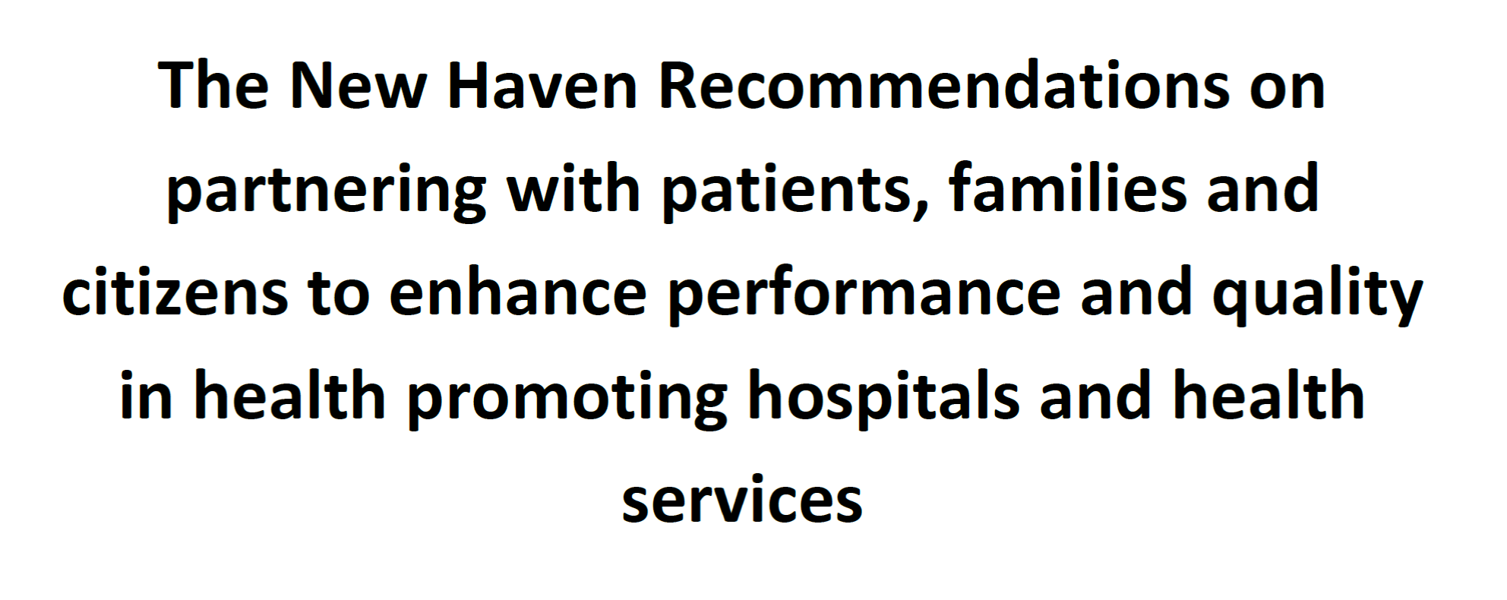

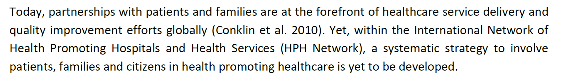

Slide 56
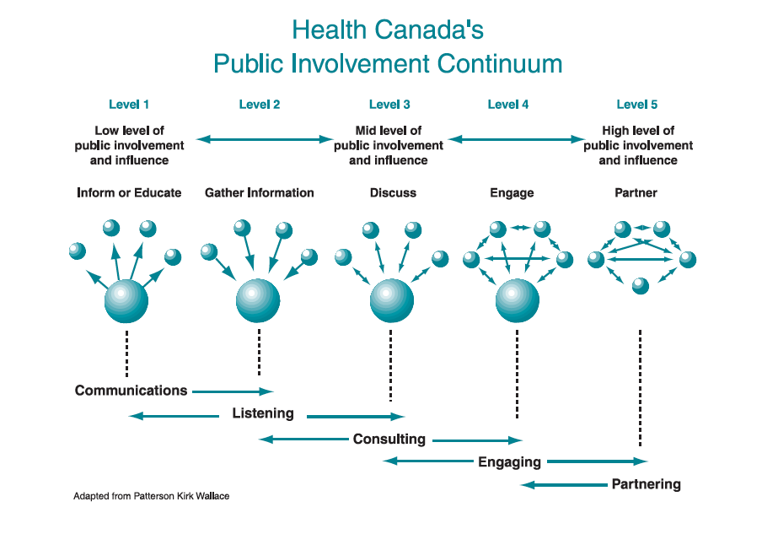
What do we mean by engagement and partnership?
Health Canada. 2000. Policy toolkit for public involvement in decision making.

Slide 57

Why Partner with Families of ICU Patients?
Families of critically ill patients
  They are the one constant across the continuum of care
  Provide significant direct care to surviving patients
    Estimated at >$642 Billion per year in costs ²
  Suffer from significant mental health issues including depression¹
1 Cameron NEJM 2016;374:1831-1841
2 Chari Health Serv Res 2015;50:871-82

Slide 58

Partnering with Patient and their Families
Partnering with families members of critically ill patients has been shown to
  decrease patient anxiety, confusion and agitation,
  reduce cardiovascular complications,
  decrease length of stay in the ICU,
  make the patient feel more secure and
  increase patient satisfaction.
Reduces family stress
Overall, it is thought to promote quality and safety in the ICU.

Slide 59
Understanding Adherence to Guidelines in the ICU:
Development of a Comprehensive Framework
CPG
Characteristics
ADHERENCE
Patient Characteristics
Implementation Process
Institutional Factors
Provider Intent
Provider Characteristics
- Profession
Critical care expertise
Educational background
Personality
System
characteristics
Hospital
characteristics
Structure
Processes
Resources
Knowledge
Attitudes
Familiarity
Agreement
Outcome
expectancy
ICU
Characteristics
Structure
Processes
Resources
Culture
Awareness
Motivation
Self-efficacy
Jones N, Suurdt J, Ouellette-Kuntz H, Heyland DK JPEN Nov 2010

Slide 60

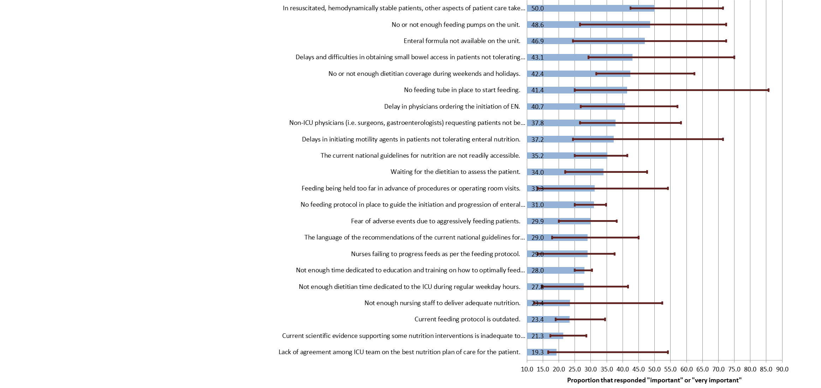
Top Barriers to Enteral Feeding
Cahill J Crit Care 2012 27(6):727-734

Slide 61
A Quotable Quote
“With critical illness, nutrition is often one of the last things on the minds of the health care team….”
Nurse in OPTICS study
How do we change the culture and make nutrition a higher priority?
Airway, Breathing, Circulation, D (Digestion), E (Early EN)

Slide 62
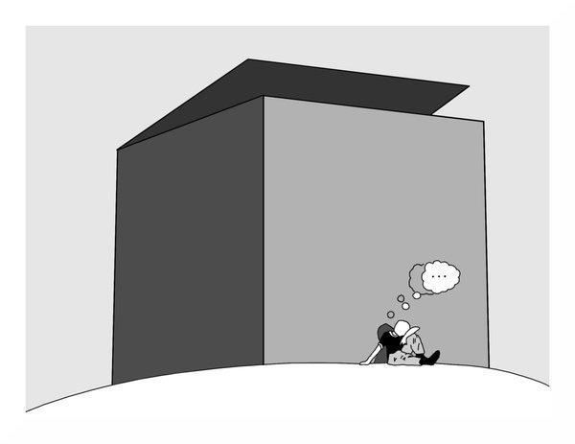
What can we do differently to change performance?
63
The same thinking that got you into this mess won’t get you out of it!

Slide 63

Overall Hypothesis
Educating families about the importance of nutrition and capacitating them advocate for better nutrition for their loved one in the ICU will result in better nutrition delivery during critical illness and in the recovery phase

Slide 64
OPTimal Nutrition by Informing and Capacitating Family Members of Best Practices
A multifaceted intervention
Family Facing
Health Care Professional Facing
Dietitian led engagement
  Obtaining nutrition history
  Providing educational sessions in ICU and ward
  Responsible for developing care plan and handover to ward staff
  Introduce Nutrition Diary tool
  Follow up in ICU and on ward
  Nutrition discharge plan for home
3-day calorie counts
Training materials (NIBBLES) for other HCP on nutrition and recovery
Orientation to the family facing materials
Posters/info graphics
Educational sessions after ICU admission and on transfer to ward
Educational Booklet and videos
Instructional video
Nutrition Diary tool
Dietitian Support thru out
Nutrition discharge plan

Slide 65
Overall Hypothesis
We aim to demonstrate that the tools and training provided to families will
  ↑ their satisfaction with care,
  ↑ their capacity to act as agents of best practice
This will translate into better patient outcomes compared to controls.

Slide 66
Specific Hypothesis
The multi-faceted nutritional strategies tested in this trial will increase nutritional best practices and patient’s physical recovery in older critically ill patients at high nutrition risk.
The multi-faceted decision-making strategies tested in this trial will increase reduce psychological distress, improve family satisfaction with decision-making, and reduce the duration of ICU stay for decedents.

Slide 67
Study Design
Nutrition Intervention
(OPTICS)
150 Eligible ‘high-risk’ patients and their family member
R
Process Measures and Short-term outcomes
Decision Support Intervention (My ICU Guide)
Usual Care

Slide 68
My Big Idea
• Creation of volunteer-driven, registry-based RCTs
• Formation of research networks to foster the growth
  or large scale projects
• Engagement of patients and families as our partners
• Shift away from physiological measurements and
  mortality to more rigorous patient centered outcomes
  including activity and performance-based measures

Slide 69

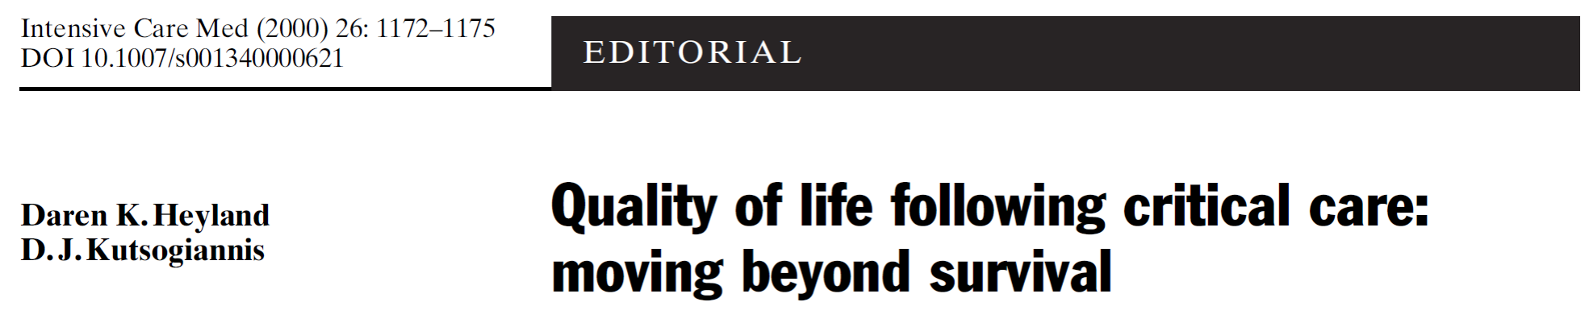

Slide 70

Evaluation Framework for Nutrition (and Exercise) Intervention Studies
Baseline Status
Including Physiology, Function, Disability, and Quality of Life
Should be Assessed with Tools that Parallel those to be used after Acute Illness
Acute
Illness
Interventions
Pathology and Impairment during illness
Assessment of structure and Function in ICU:
e.g. Protein balance, muscle mass, biopsy, nerve conduction studies, etc.
Activity Limitations Following Illness
Assess Activities in a Standardized Research Environment (Prior to hospital discharge)
e.g. 6 MWD, TUG, grip strength, etc.
Participation Restriction
Assess Participation in Usual Environment (following hospital discharge) e.g. SF-36 Physical Function domain, IADL, ADL, etc.
Quality of LIfe
Assess Holistic QOL in Usual Environment (6-12 months later) : e.g. EQ-5D, SF-36, etc.
Heyland Clin Nutr 2015
Notes:
An important conversation we need to have as a society is whether we should expect dietitians/nutritionists to take ownership of the physical recovery of patients. Do we expect nutritional interventions to impact these physical outcomes? If so, can we expect dietitians to monitor muscle mass, muscle strength, etc? eg. Of nutritionist in Buenos airies where they followed patients to discharge.

Slide 71

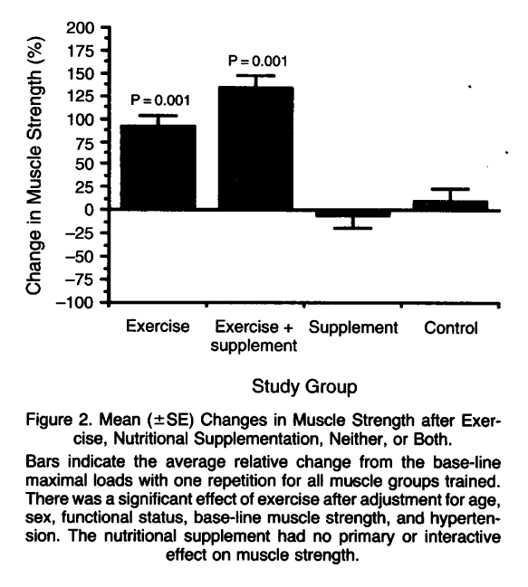
Exercise Training and Nutritional Supplementation for Physical Frailty in Very Elderly People
Fiatarone, NEJM 1994;330:1769-1775.
Notes:
As we think about the physical recovery of our patients… evidence that it is the combination of ….. But what do you as dietitians know about activity/exercise? What do you our rehabilitation partners know about nutrition.

Slide 72
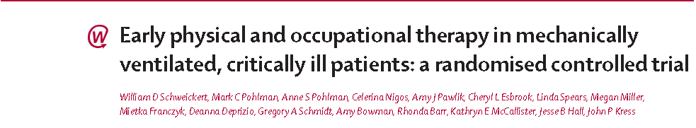
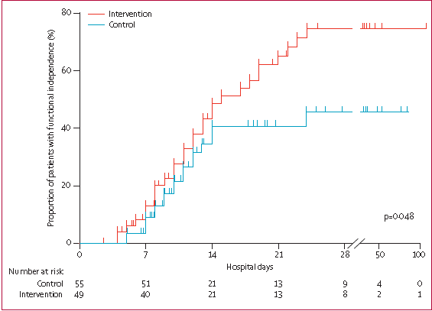

Lancet 2009;273:

Slide 73


The NEXIS Study
(Nutrition and EXercise Interventional Study in critically ill patients)
Bedside cycling ergometry
and IV amino acids
(2-2.5 grams/kg/day)
Primary Outcome
6 min WD
142 ICU patients
Projected length of
stay >3 days
R
Concealed Stratified by
Site
Secondary Outcome
HRQOL
ADL/IADL
Muscle strength
Fed enterally
Usual Care
(bed rest and underfeeding)
In collaboration with Renee Stapleton and Dale Needham
Funded by NIH

Slide 74
Conclusions (1)
Poor evidentiary basis for clinical nutrition at root of addressing malnutrition and underfeeding
Limitations of large-scale RCTs need to drive us to develop alternative solutions for some research questions
RRCT is a possible solution
Can the INS ‘registry’ be adapted to serve the clinical nutrition community to develop ability to generate high(er) level evidence that broadly applicable?
‘Issues’ need further discussion

Slide 75
Conclusions (2)
Creation of clinical research networks has the potential to accelerate and support large-scale innovative trials
Community mentoring model in context of protocol development meetings ensures quality of project and growth of community
Engaging patients and families in our efforts will transform the valuation of clinical nutrition and impact on outcomes
Measure things that matter to them

Slide 76
Why Should I engage in Clinical Research?
Research influences how the world thinks!
Research informs policy and practice!
May provide some academic credit (if important to you)
Contributes to an enhanced sense of professionalism
Leads to new contacts, colleagues and networks
Fun!
Improve Patient Outcomes!

